Slide 1
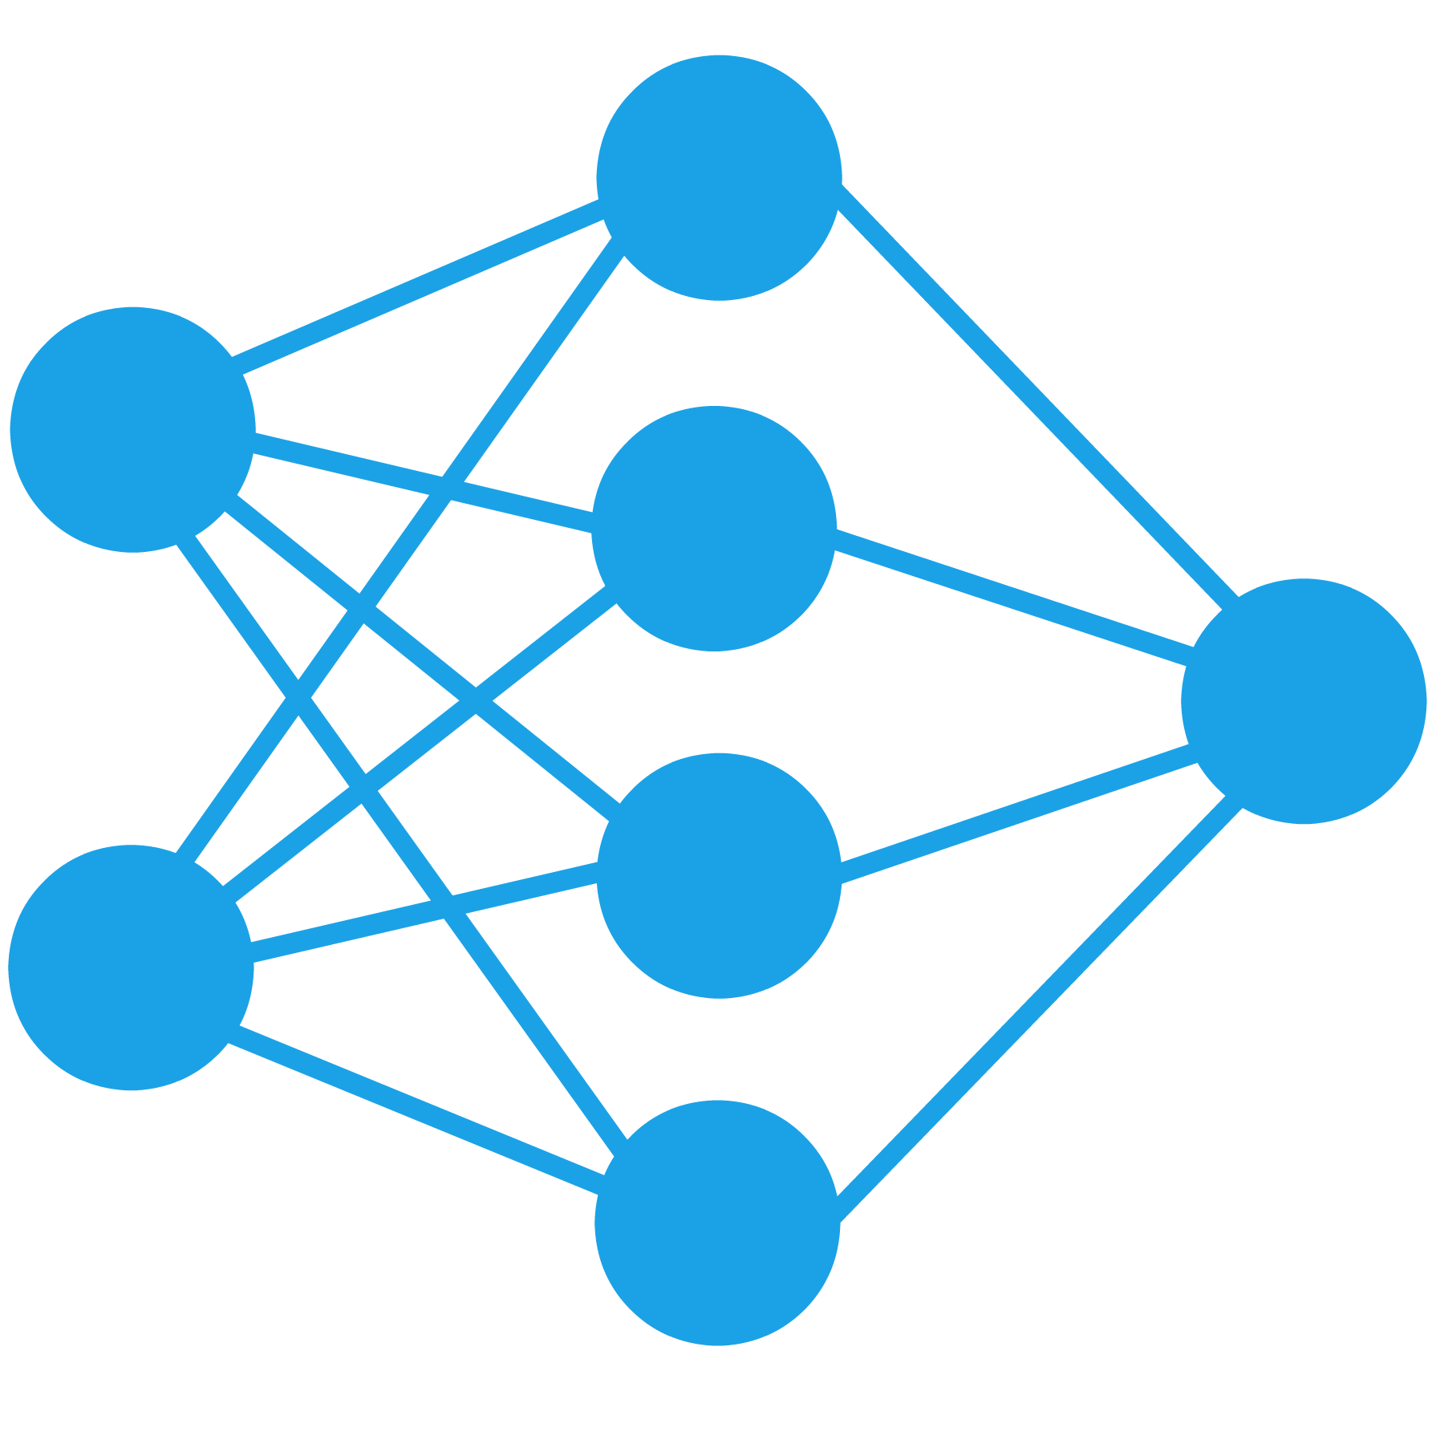
Data Science Meetups
Empowering Booz Allen analytics through data science
July 13, 2018
Booz Allen Hamilton and Client proprietary and confidential

Slide 2

Announcements
Data science 5k (DS5K) wave 4 Starts July 9!
Anyone here doing it?
Let us know what you’re interested in
Quick survey
You can use your phone
It’s completely anonymous, we can prove it!
Join the group for updates
You can view our site, Slack channel, etc. without joining
But, updates are sent to the group
Group notifications will be muted by default
Event invites are sent to member list’s emails
Visit https://boozallen.sharepoint.com/sites/socal-ds-meetups
Brown bag Lunch Sessions
“Python for Data Analysis, 2nd Edition” by Wes McKinney
Learn how to do specific tasks in a casual environment
QR to survey

Slide 3
Guest Speaker
Aaron Penne

Slide 4

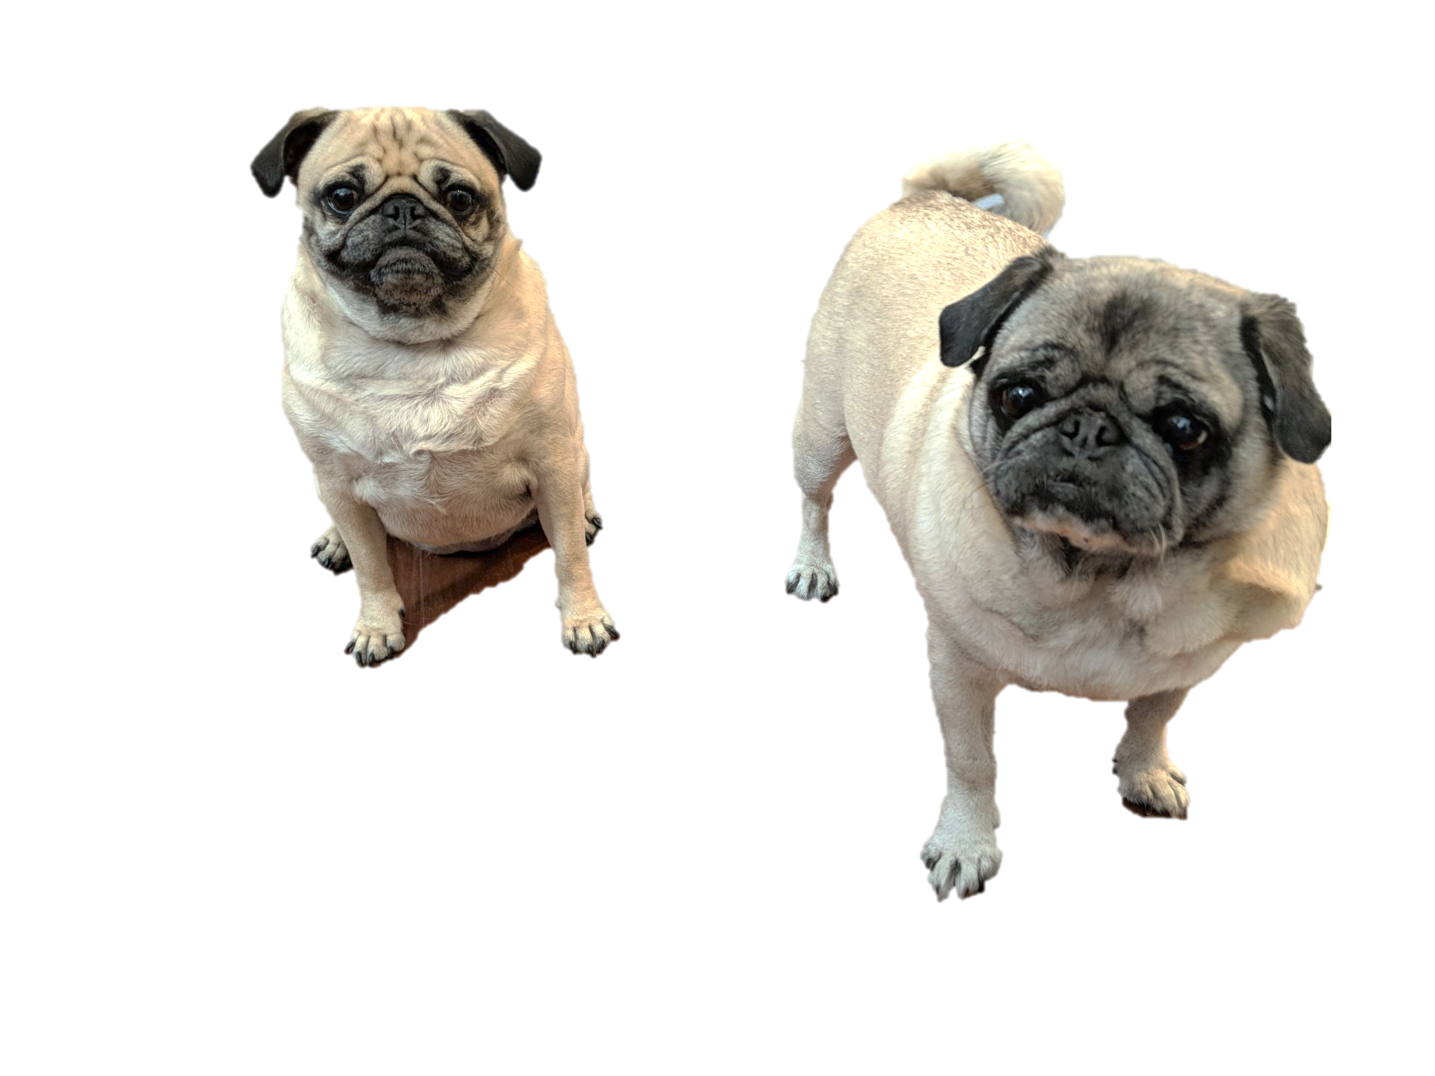
About Me – Aaron Penne
Data Scientist – SIG
BS Electrical Engineering SDSU
MS Electrical Engineering UCSD
EE @ Northrop Grumman on Global Hawk
Data was more interesting than the components measuring the data
Contact Info
Email: penne_aaron@bah.com
Slack: Aaron Penne
Links: Github | Linkedin

Slide 5
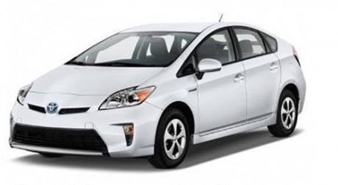
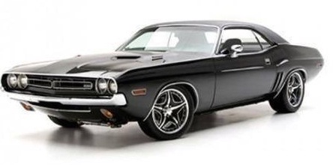
Clustering! What is it?
Discovering something new
Reveal inherent patterns/groupings in the data
Create groups of data that are more similar to each other than data in other groups
Create new feature (column) for more information
Where is this used?
Social media trend analysis
Machine learning classification
Identifying customer segments
Analyzing population demographics

Slide 6

Let’s Give it a Try
Setup
Doing research on cars, have tons of specs but no labels!
Unsupervised learning, don’t know the answers
Want to get some answers
MPG vs Cost
Questions
Can you identify any clusters as concentrated data points?
What if you had to select 2 clusters?
How about 3 clusters?
How exact can you get? What if they overlap?
Miles Per Gallon
Cost

Slide 7
Let’s Give it a Try
Hybrids
?
Miles Per Gallon
Miles Per Gallon
Sports Cars
Cost
Cost
Notes:
Hard to do manually, but computer can do a pretty good job
Right plot categorized with a machine learning algorithm

Slide 8
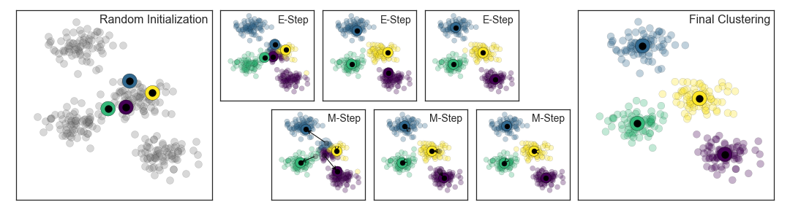
How Can Data Science Help?
K Means Clustering
What if we had lots of columns? Millions of rows?
The Algorithm
Pick a number of clusters (this is a tricky part)
Place that number of dots (centroids) on the data
Assign points to the nearest centroid
Move the centroids to the mean (average) of that cluster
Repeat steps 3 & 4 until there is no more movement!
Expectation-Maximization (EM)
Expectation step (step 3) updates our guess
Maximization step (step 4) maximizes some function, in this case that means calculating the mean
https://jakevdp.github.io/PythonDataScienceHandbook/05.11-k-means.html

Slide 9
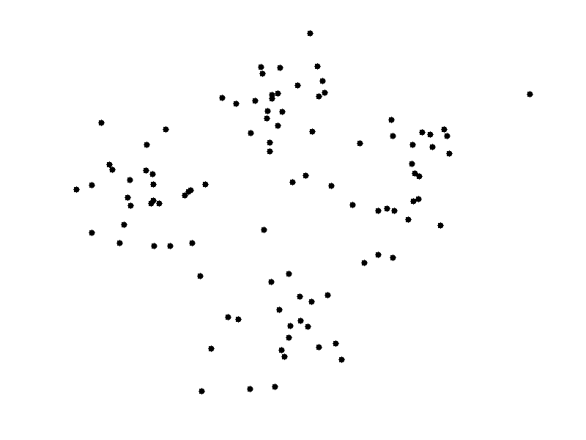
K Means Clustering – In action!
How many clusters does this appear to have?
Where are they?
http://shabal.in/visuals.html

Slide 10
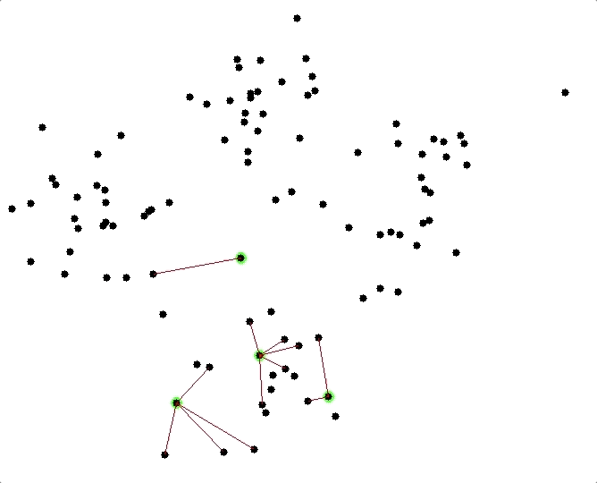
K Means Clustering – In action!
Let’s start with 4 clusters.
Let the computer solve it!
http://shabal.in/visuals.html
Notes:
Every point gets assigned to a centroid
Updated to mean
Repeat
Important to pick the right(ish) amount of clusters

Slide 11
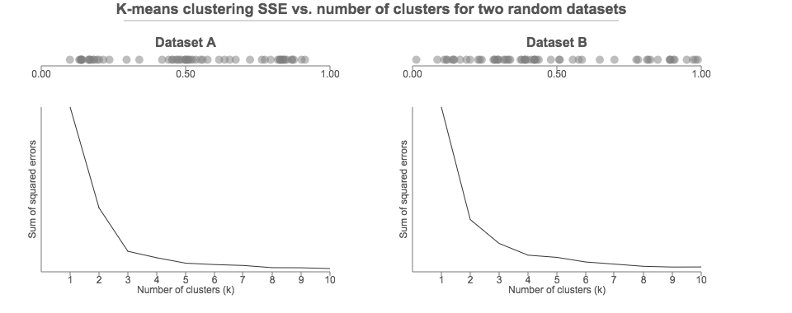
How to pick the number of clusters
The right number of clusters matters
Bit of an artform
When in doubt use more clusters then combine them
The elbow method is one way to quantify
Run K-means with 1 cluster, calculate error, run again with 2 clusters, calculate error, repeat
Want to minimize error, but diminishing returns

Slide 12
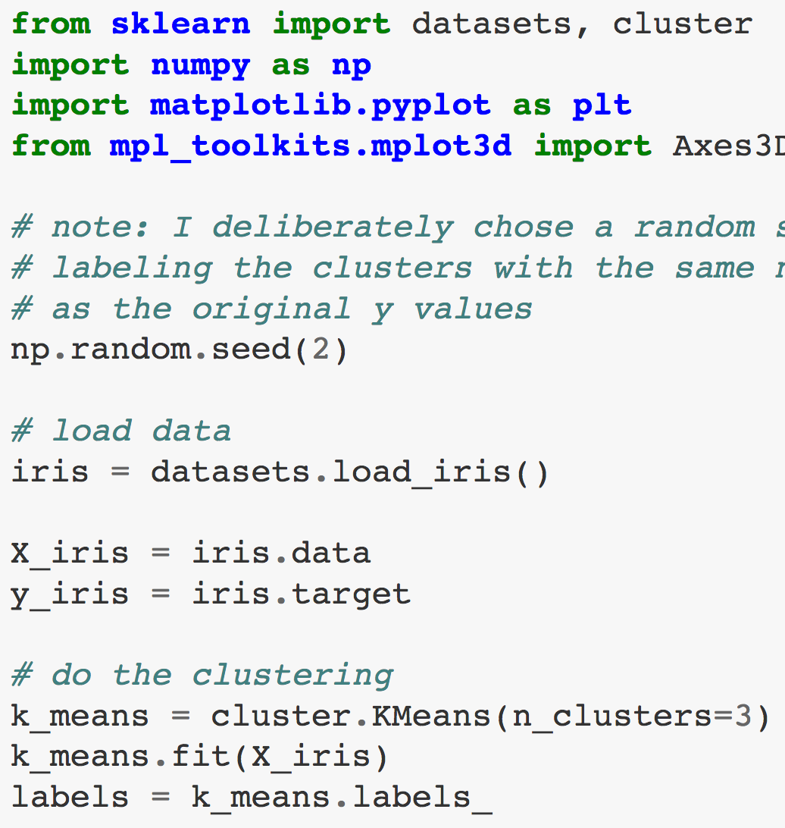
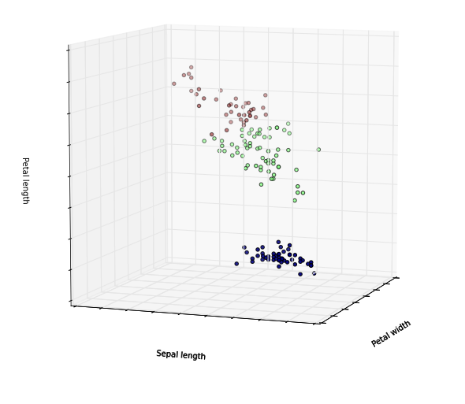
Python example with scikit-learn
Powerful reason to use k-means
Large datasets can be used
Millions of rows or more!
Even if it was 2D, Excel might break
It is hard to visualize data in more than 2 or 3 dimensions.
2D = flat scatterplot
3D = scatterplot box
4D = scatterplot box with varying shapes?
5D = open a rift in space/time?
https://gist.github.com/bbarrilleaux/9841297

Slide 13
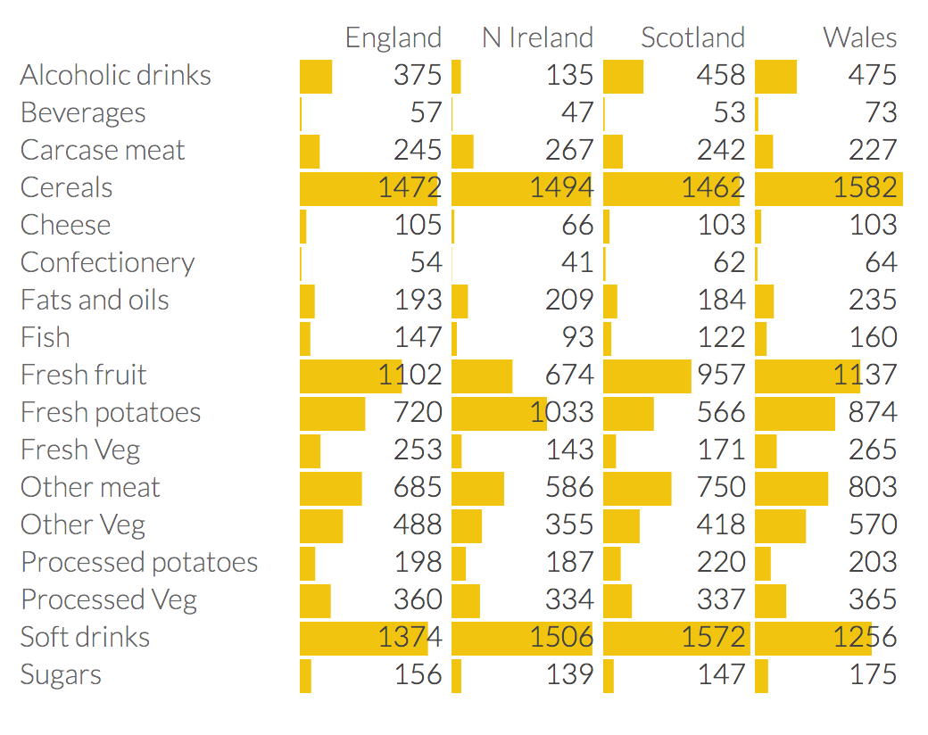
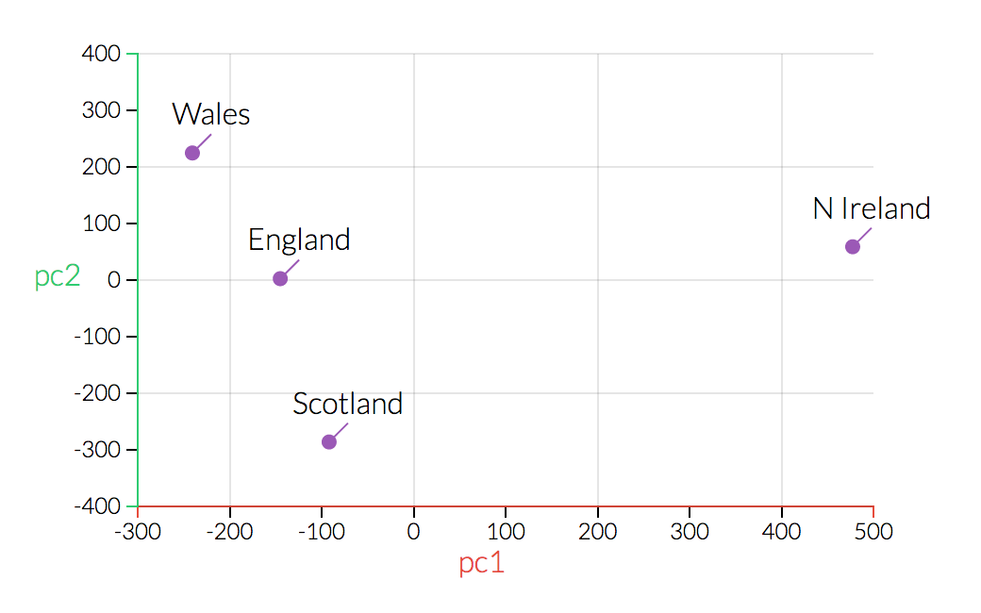
Highly Dimensional example - Eating in the UK
17 Dimensions
Reduced to 2 Dimensions using PCA
Cool! Now what?
North Ireland is different from the others
Solve a problem
Can ignore it as an outlier
Can deep dive on N Ireland data to find why (Potatoes/Fruit)
http://setosa.io/ev/principal-component-analysis/

Slide 14
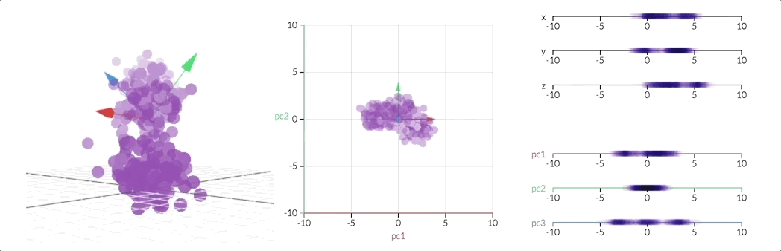
Dimensions = Columns = Features
Principal Component Analysis
Method of summarizing some data, reducing dimensionality
Dimensions are just columns in data
Example:
Fruit can be described by its color, weight, length, etc.
If some of these are related, they may be redundant, so we can condense two dimensions into one!
Awesome explanation: https://stats.stackexchange.com/a/140579/201844
Helps to visualize, cluster, and select important features (columns)
http://setosa.io/ev/principal-component-analysis/

Slide 15
after Clustering and classification
New data point
Use model in 2 ways:
Plug it in and see which category it falls under
Re-run K-Means with updated dataset
CompleteD model, now what?
Solve a problem or answer a question
What proposals is this new one most like?
Would this group perform better with a different schedule?
Perform A/B testing on different groups
Identify what the root cause is of separation
Go learn the next algorithm!

Slide 16
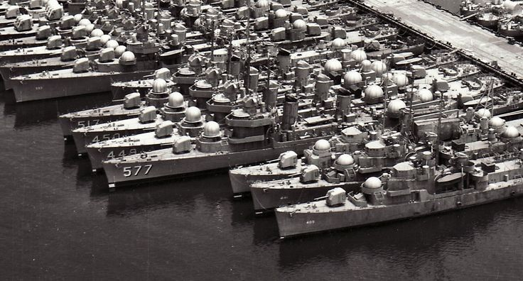
How Does this relate to Client work (SPAWAR, etc)?
Business use cases
SPAWAR
Cluster ships
Cluster PMOs/WBS
Different customer segments
Respond differently to promotions
Want different services
Data Science projects
PMO/Project comparison
Cluster/classify programs based on how they spend their money
See which WBS elements are for which PMOs
Find similar programs to current/new ones
Proposal writing
Could use historical data to do trend analysis
Clustering vendors based on technology/budget, etc.
Ideas?

Slide 17
How could this be useful at work?
SPAWAR/PMO Work Breakdown Structure (WBS) Example
A
B

Slide 18
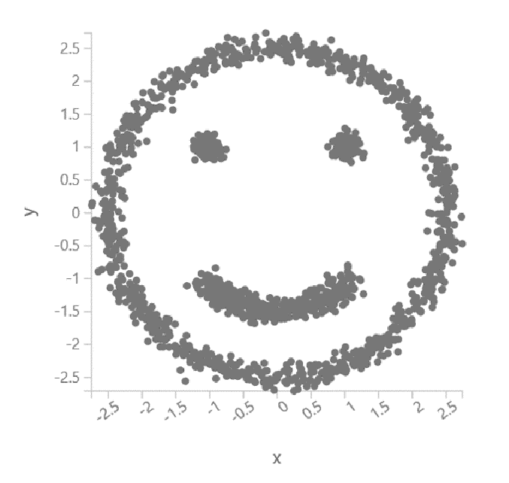
Thank you!

Slide 19
Q&A
Discussion

Slide 20
backup

